Slide 1
Stereo Depth
By Yonatan Feleke
December 12, 2017

Slide 2
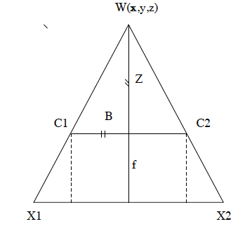
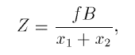
Introduction
Depth of a scene can be calculated using triangulation
Two or more images of the same scene (C1, C2)
Camera properties such as focal length(f) and base line (B)
Algorithms can be categorized as
Plane sweeping
Local optimization
Global Optimization
Notes:
Locall Optimization and Global optimizations differ in :
Smoothing considerations
Searching in neighboring pixels versus globally

Slide 3
Stages of Stereo Algorithms
Rectification – Translation, Rotation, Rigid, Affine, Shear
Matching cost functions, mostly based on intensity
Examples: Squared differences, Absolute difference, correlation, Birchfield/Tomasi
Cost aggregation over image
Minimize computed cost or mismatch
Disparity computation or optimization
Subpixel expansion
Disparity refinement
Left to right correspondence
Notes:
Szeliski taxonomy The most common pixel-based matching costs include
squared intensity differences (SD) [51, 1, 77, 107] AKA mean-squared error (MSE)
absolute intensity differences (AD) [58]. AKA and mean absolute difference (MAD) measures;

Slide 4
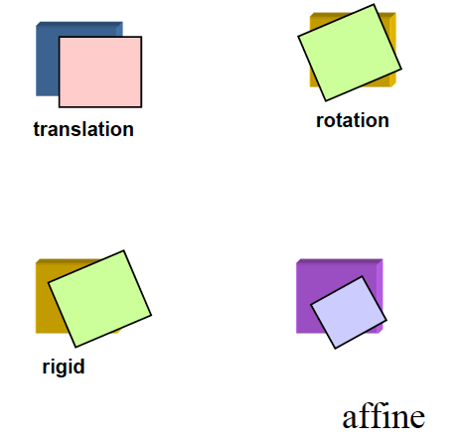
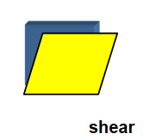
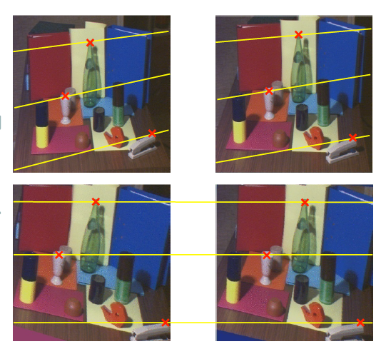
Rectification
Examples of translations
Aligns epipolar lines
Removes lens distortions
Notes:
Translation source:http://crcv.ucf.edu/courses/CAP5415/Fall2012/Lecture-8-MotionModels.pdf
Rectfication source: http://vision.deis.unibo.it/~smatt/Seminars/StereoVision.pdf

Slide 5
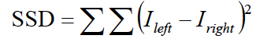
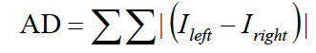
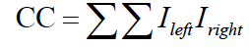
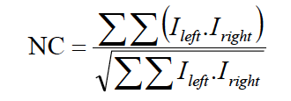
Cost Functions
Sum of squares difference
Absolute difference
Cross correlation
Normalized Correlation
Measure of how correct the set of matches are
Intensity based matching will have errors
Occlusion
Geometry
The value to minimize or maximize
Notes:
Equations source: http://crcv.ucf.edu/courses/CAP5415/Fall2012/Lecture-16-Stereo.pdf

Slide 6
Stereo Correspondence
The way algorithms go about identifying pixel matches separates them into the two categories of local and global methods.
Local algorithms have a sliding reference block that is searched in the paired image within a local area.
Global optimization functions aim to minimize an energy function across entire image or epipolar scan line.
The energy depends on matching errors and a smoothing function.

Slide 7
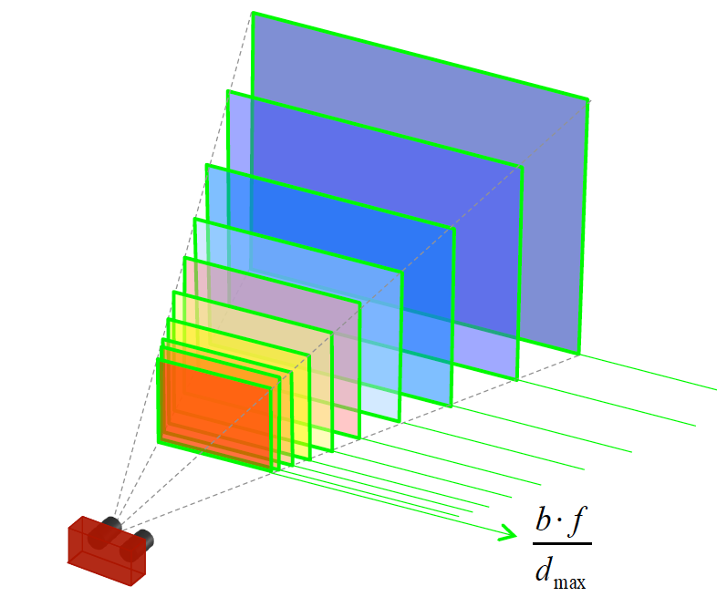
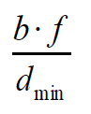
Sub Pixel Optimization
Disparity values are integers
Depth values are per pixel and discrete
Optimization tries to fit a quadratic curve to interpolate depth map

Slide 8
Local Algorithms
Block based

Slide 9
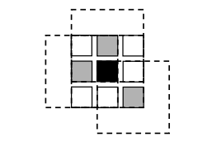
Block based depth estimation
Many implementations with different pre-processing implementations
Features subpixel expansion and left to right correspondence
The simplest algorithm to understand
WTA approach to selecting disparity
Real-time application
Very susceptible to occlusions, depth discontinuity and low textured regions
Notes:
The local solutions also do not take advantage of smoothing functions as described in global optimization solutions.
Most algorithm methods also use a "left right consistency" disparity refinement step to improve on the captured images
This step helps mitigate some of the occlusion issues.
Image source Computer Vision: Algorithms and Applications Szeliski

Slide 10
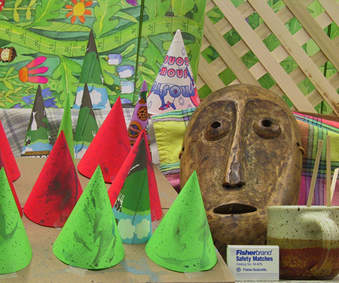
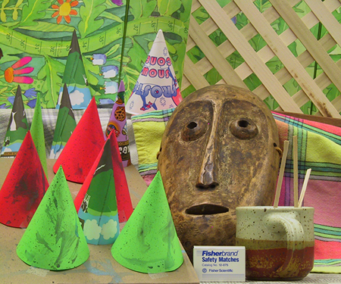
Cones Data set 2003
Left View
Right view

Slide 11
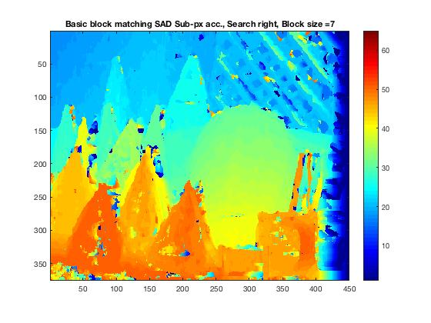

Block based Mask
Sum of Absolute Difference
Sum of Squared Difference

Slide 12
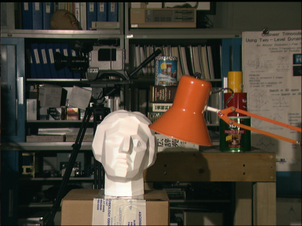
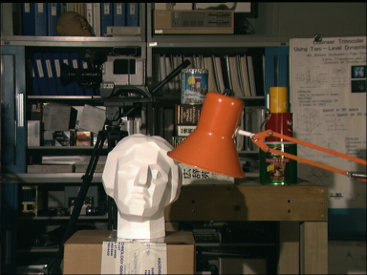
Tsekuba Data set 2001
Left View
Right view

Slide 13
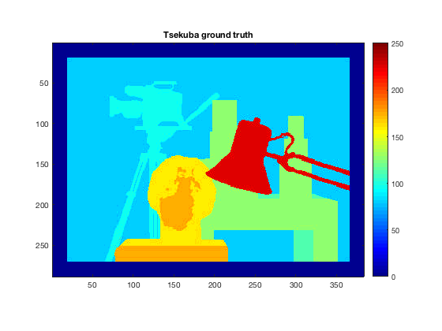
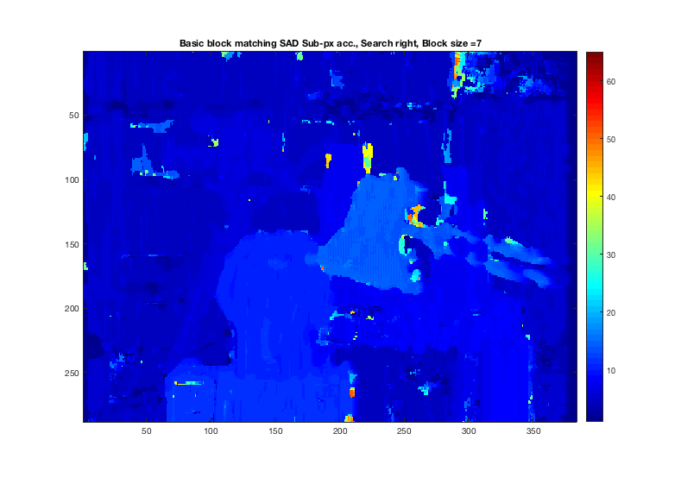
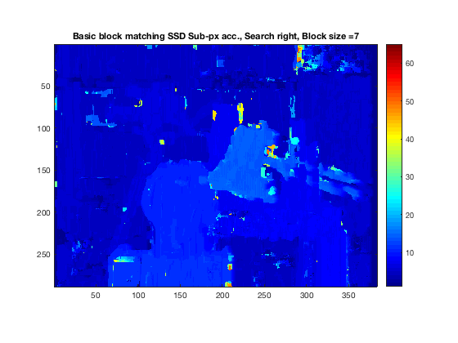
Block based Bust
Ground
SAD
SSD
Good depth continuities are handled well

Slide 14
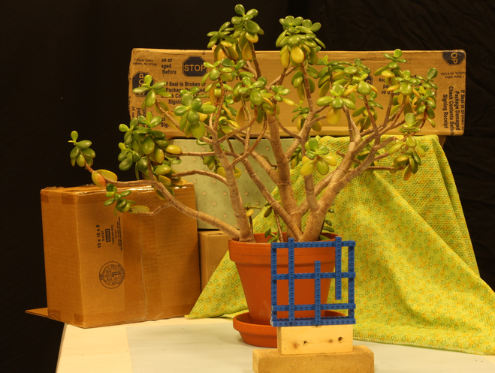
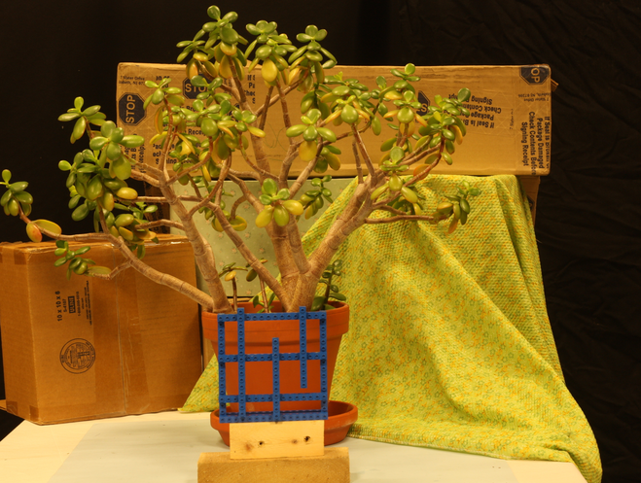
Jade Data set
Left View
Right view
Notes:
High occlusion
High depth discontinuity

Slide 15
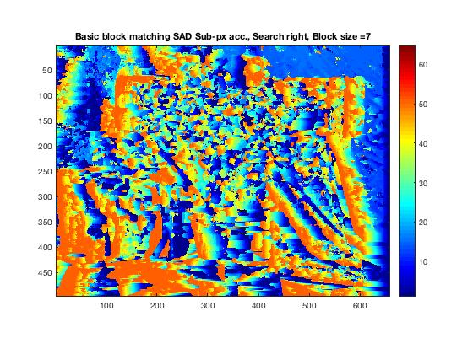

Block based Jade
Ground
SAD
SSD
As expected block based approaches struggle with depth discontinuities and occlusion

Slide 16
Global Algorithm
Semi Global
Dynamic programming
Belief propagation
Graph Cut or Expansion
Iterated Conditional Methods

Slide 17
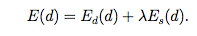
Global Algorithms
The pixel optimization is done at a global level so solutions handle occlusion and depth discontinuity much better than block based methods
Smoothness - The expectation that neighboring pixels have similar depth is also enforced by a weight (lambda)
Scanline implementations are done by dynamic solutions while two dimensional solutions are efficiently computed by Belief propagation and graph cuts

Slide 18
Tsekuba Data set
Left View
Right view

Slide 19
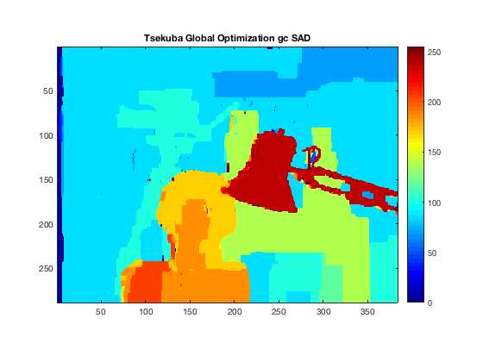
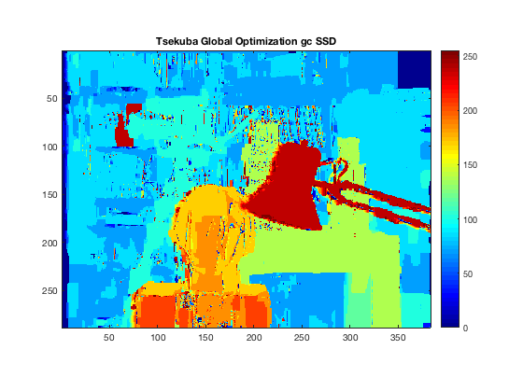
Global based Tsekuba
Ground
SAD
SSD
Graph cuts perform the best from the global optimization methods tested
Sum of squared differences has more noise but also captures more detail
Notes:
Utilized midlebury MRF cpp script and matlab to generate disparity images

Slide 20
Jade Data set
Left View
Right view
Notes:
High occlusion
High depth discontinuity

Slide 21
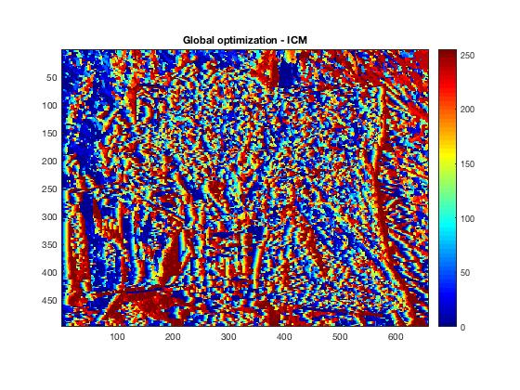
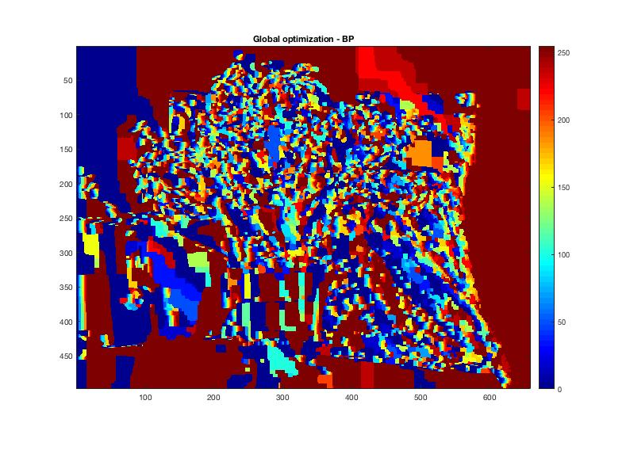
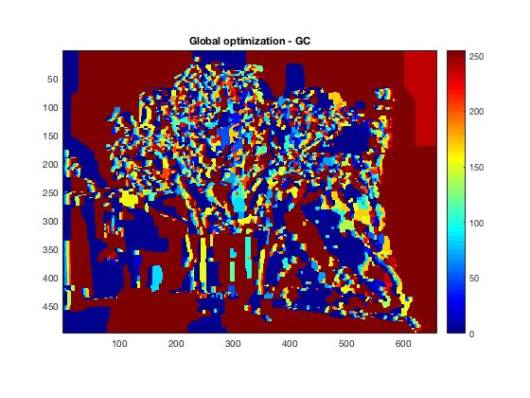
Global based Jade
ICM
Belief Propagation
Graph cut
The block method has faster execution times but graph cuts handle occlusion much better
Algorithm implementations have small change
Notes:
Utilized midlebury MRF cpp script and matlab to generate disparity images

Slide 22

State of the Art - CNN
Zbontar et. al paper kicked off the neural network arms race
KITTY -
Middlebury
The networks are trained to identify similarity score for the stereo correspondence step
Highly tolerant to occlusion and depth discontinuity with a priori training
Notes:
Zbontar - Stereo Matching by Training a Convolutional Neural Network to Compare Image Patches

Slide 23
Thank you!
Question?

